Slide 1
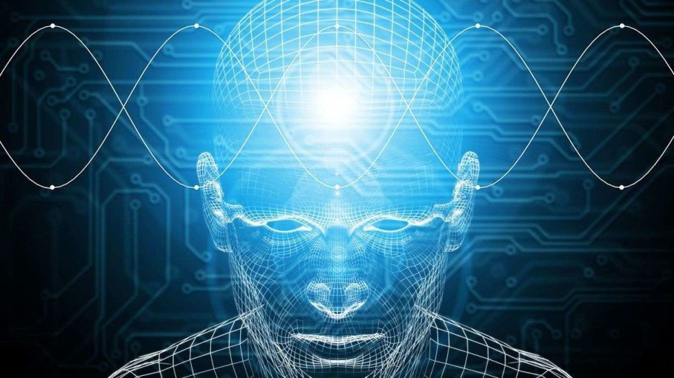
Artificial Intelligence and Data Science
人工智能和数据科学

Slide 2
作者简介：
姓名：王冲野
部门：公安事业部
出生日期：1998-08-20
学校：现就读于美国伊利诺伊大学香槟分校
专业：计算机&统计
研究领域：人工智能, 机器学习, 文本挖掘, 推荐系统, 数值分析
邮箱：wangchongye@hikvision.com.cn wangchongye@126.com

Slide 3
Why?

Slide 4
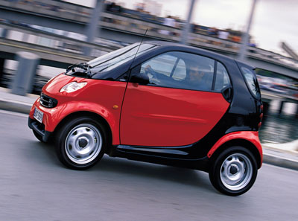

Slide 5
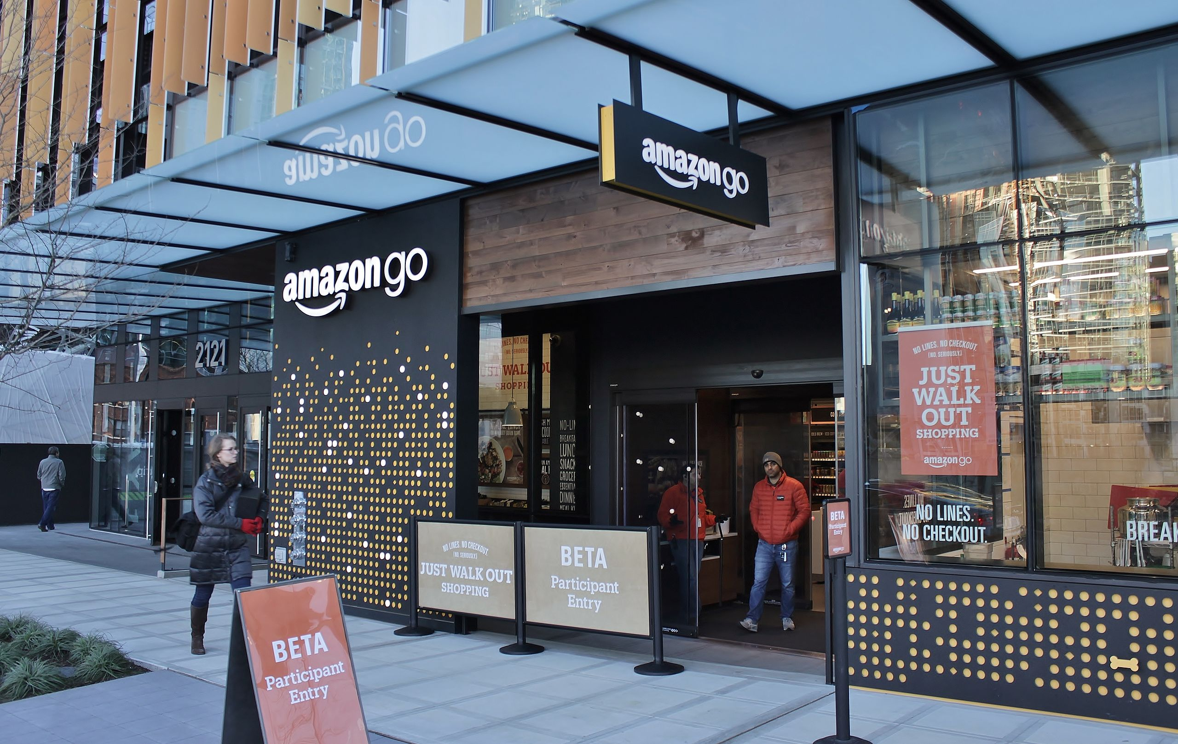

Slide 6


Slide 7




Slide 8
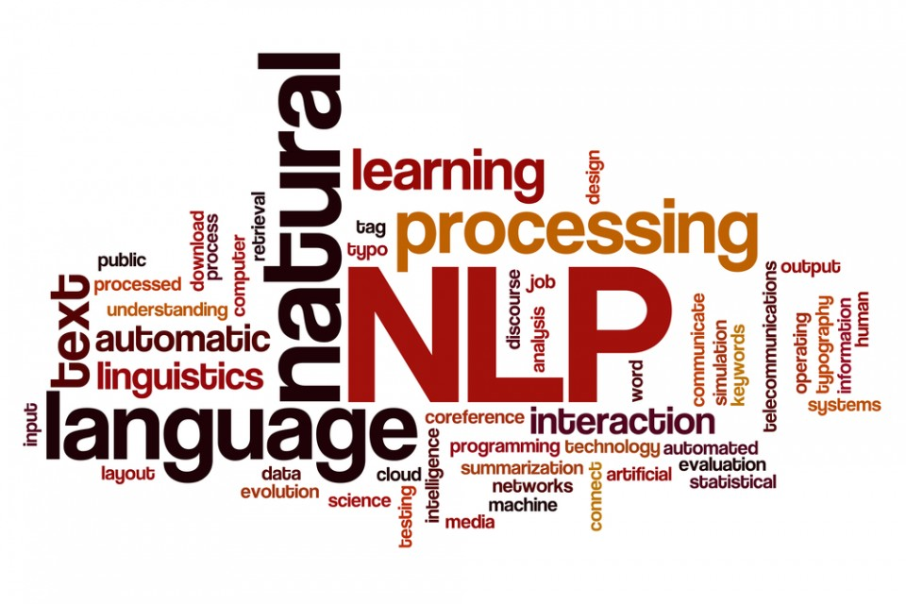
Natural Language Processing
自然语言处理

Slide 9
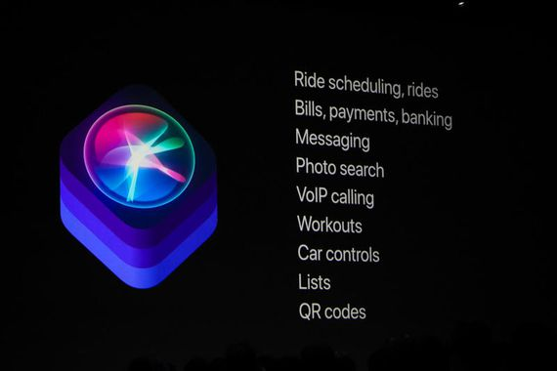

Slide 10
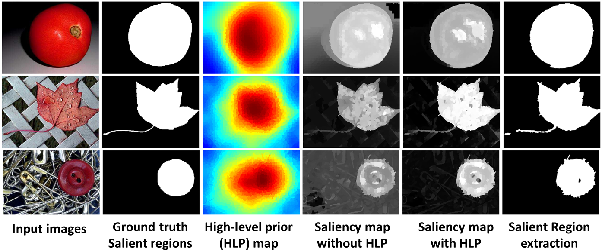

Slide 11
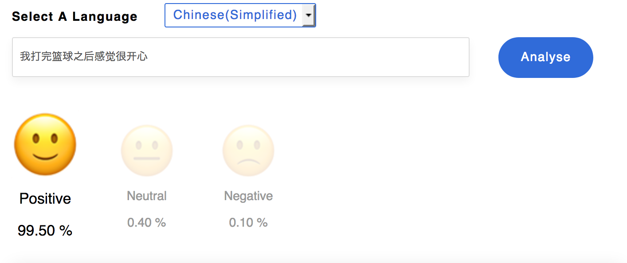

Slide 12
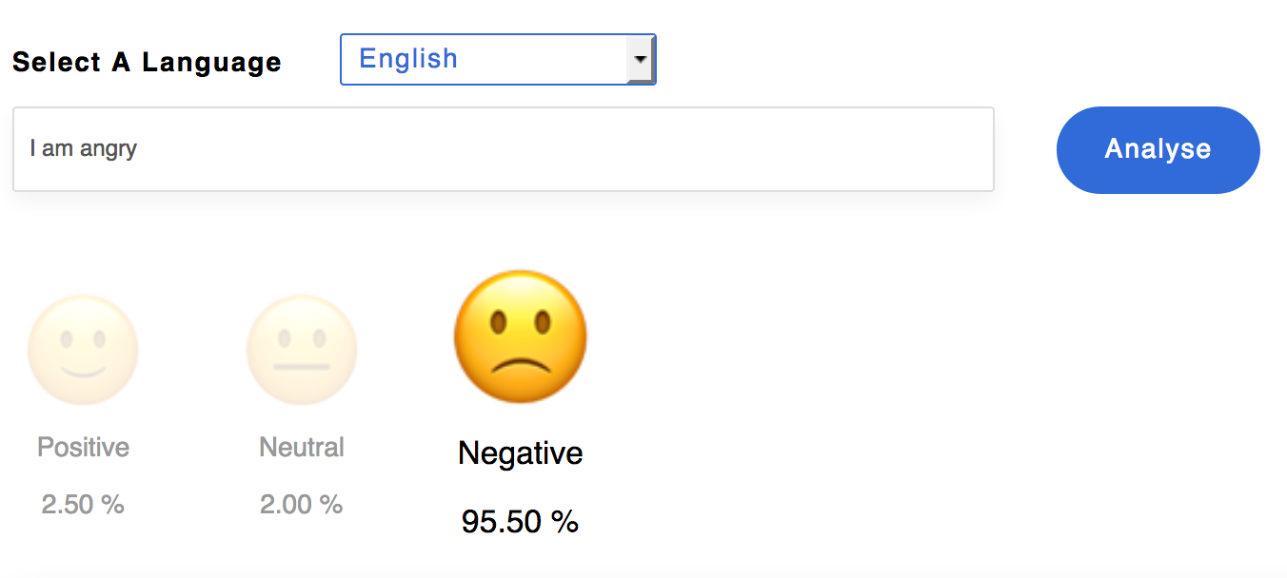

Slide 13
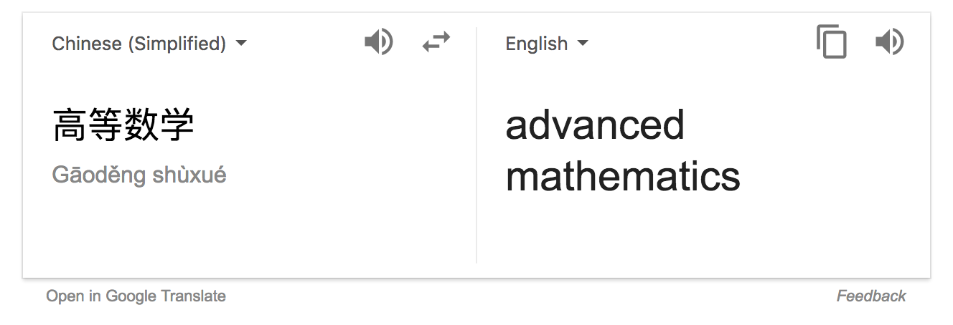

Slide 14
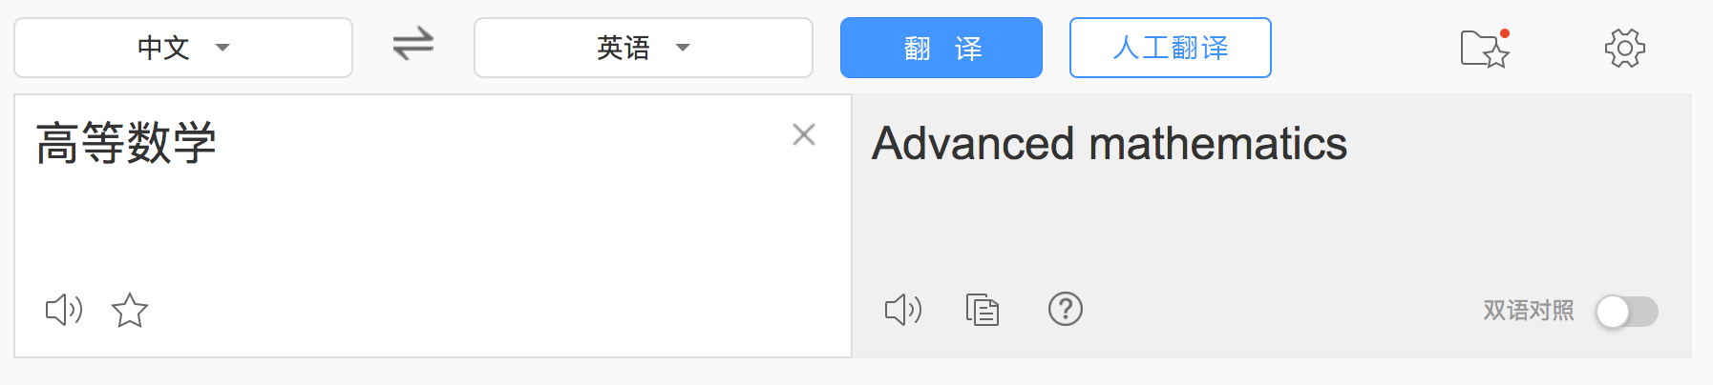

Slide 15
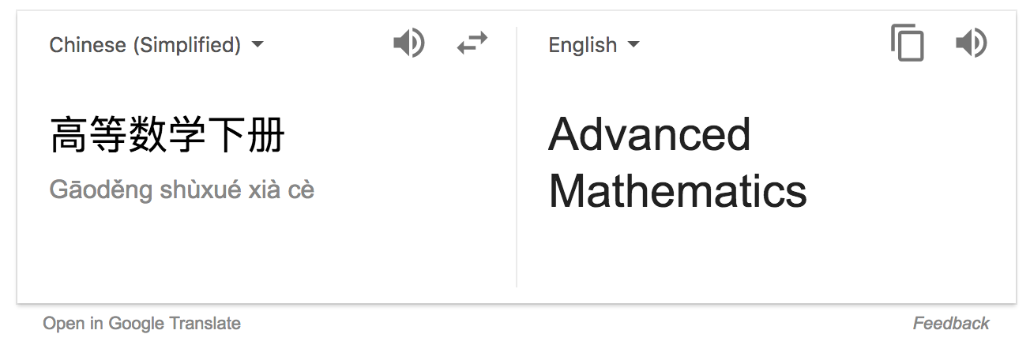

Slide 16


Slide 17
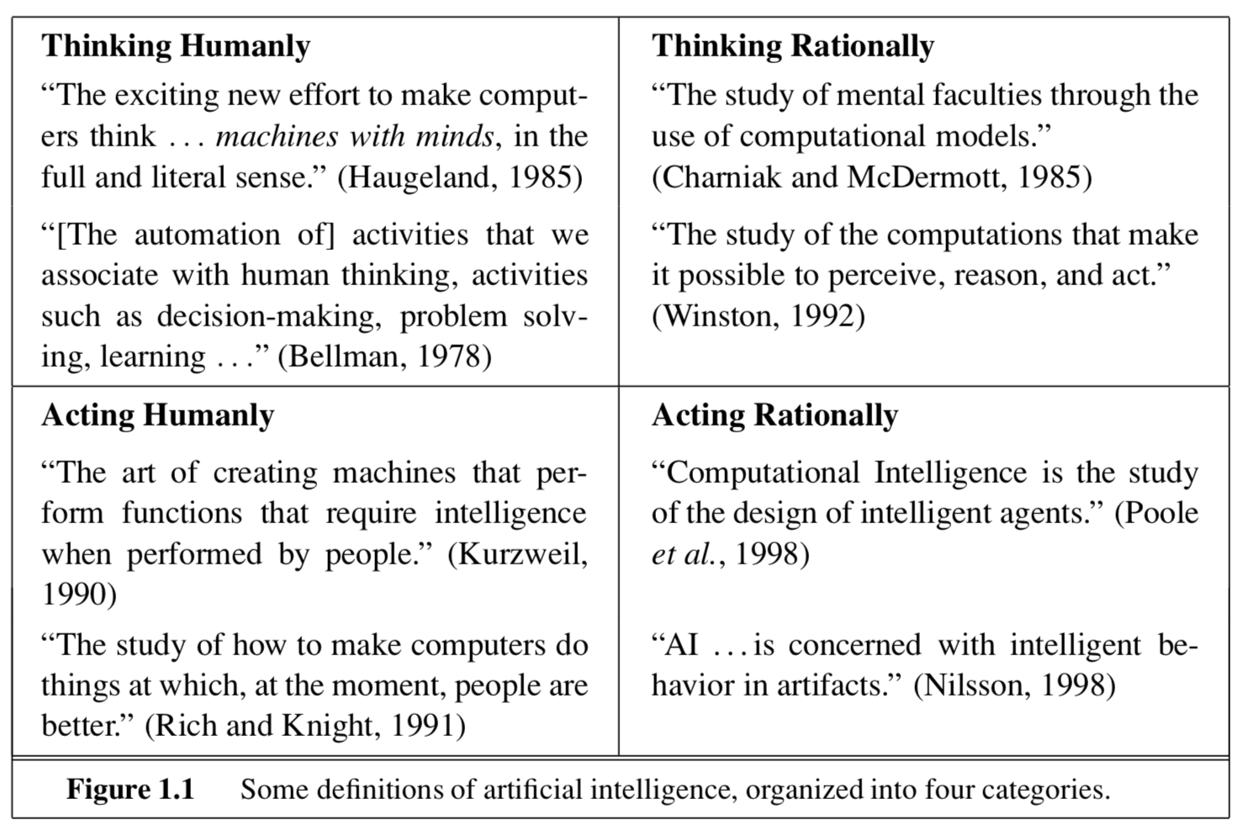
History of AI

Slide 18
What is artificial Intelligence 什么是人工智能？
Artificial intelligence (AI), sometimes called machine intelligence, is intelligence demonstrated by machines in contrast to the natural intelligence displayed by humans and other animals.
---wikipedia
人工智能（英语：artificial intelligence，缩写为 AI）亦稱機器智能，指由人製造出來的機器所表現出來的智能。通常人工智能是指通過普通電腦程式的手段實現的人類智能技術。該詞也指出研究這樣的智能系統是否能夠實現，以及如何實現科學領域。同時如此，人類的數量開始收斂及功能逐漸被其取代。
---维基百科

Slide 19
The theory and development of computer systems able to perform tasks that normally require human intelligence, such as visual perception, speech recognition, decision-making, and translation between languages.

Slide 20
What is Data Science 什么是数据科学
Data science is an interdisciplinary field that uses scientific methods, processes, algorithms and systems to extract knowledge and insights from data in various forms, both structured and unstructured, similar to data mining.
-wikipedia

Slide 21
Relation between artificial intelligence and data science 人工智能和数据科学的关系

Slide 22
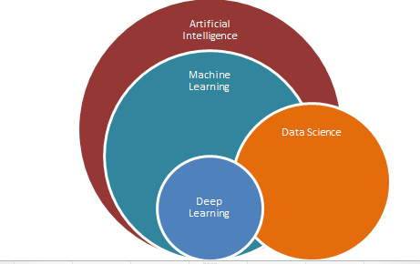

Slide 23
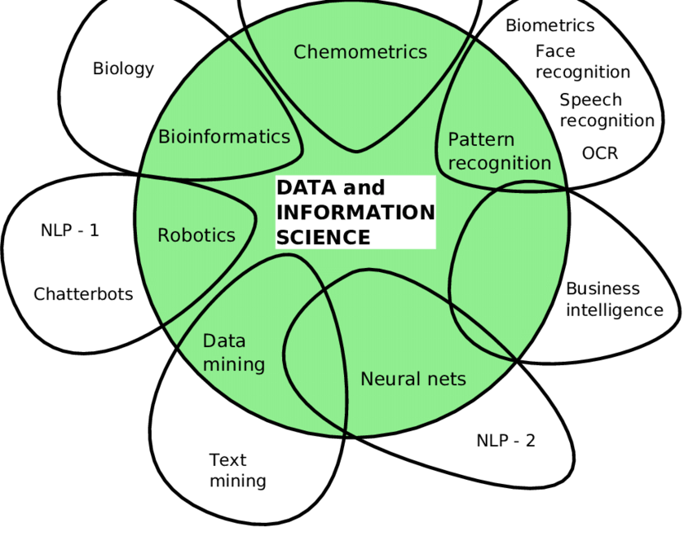

Slide 24
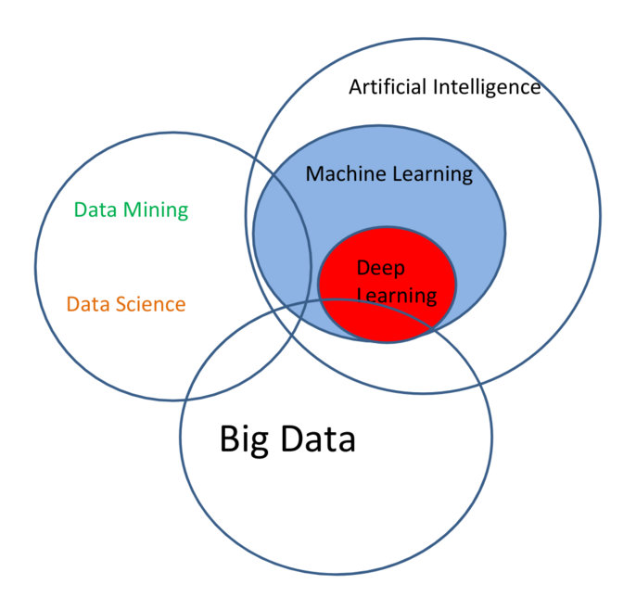

Slide 25
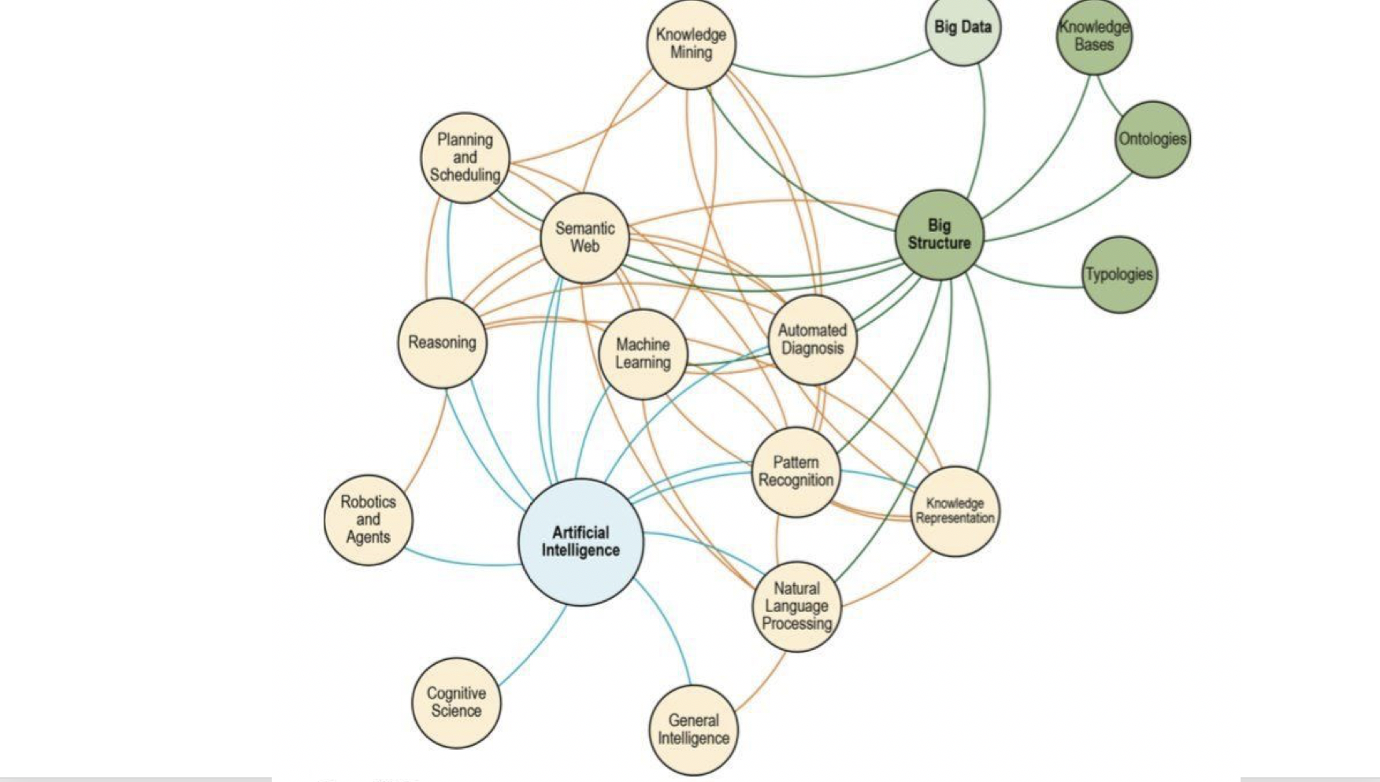

Slide 26
Machine Learning 机器学习
Text Retrieval 文本检索
Data Mining 数据挖掘
Reinforcement Learning 强化学习
Recommender System 推荐系统
Deep Learning and Neural Network 深度学习和神经网络

Slide 27
MACHINE LEARNING 机器学习

Slide 28
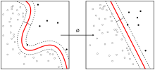
What is machine learning 什么是机器学习
Machine learning is a subset of artificial intelligence in the field of computer science that often uses statistical techniques to give computers the ability to “learn” (i.e., progressively improve performance on a specific task) with data, without being explicitly programmed.
---wikipedia

Slide 30
机器学习和人工智能的关系： 机器学习是实现人工智能的方法

Slide 31
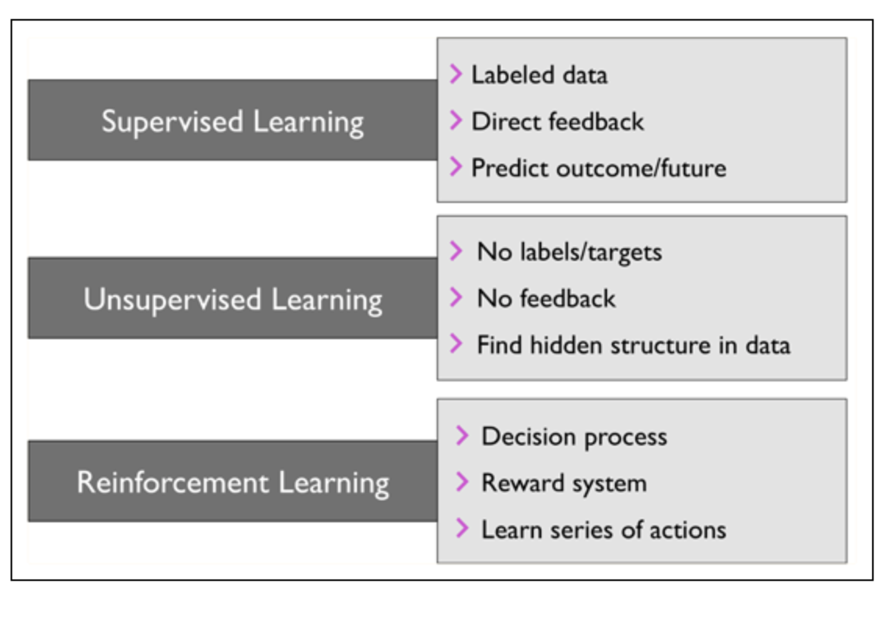

Slide 32
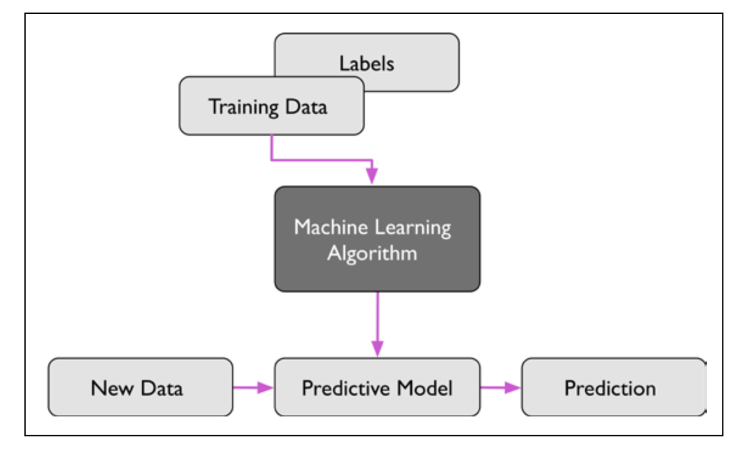
supervised learning 监督学习

Slide 33
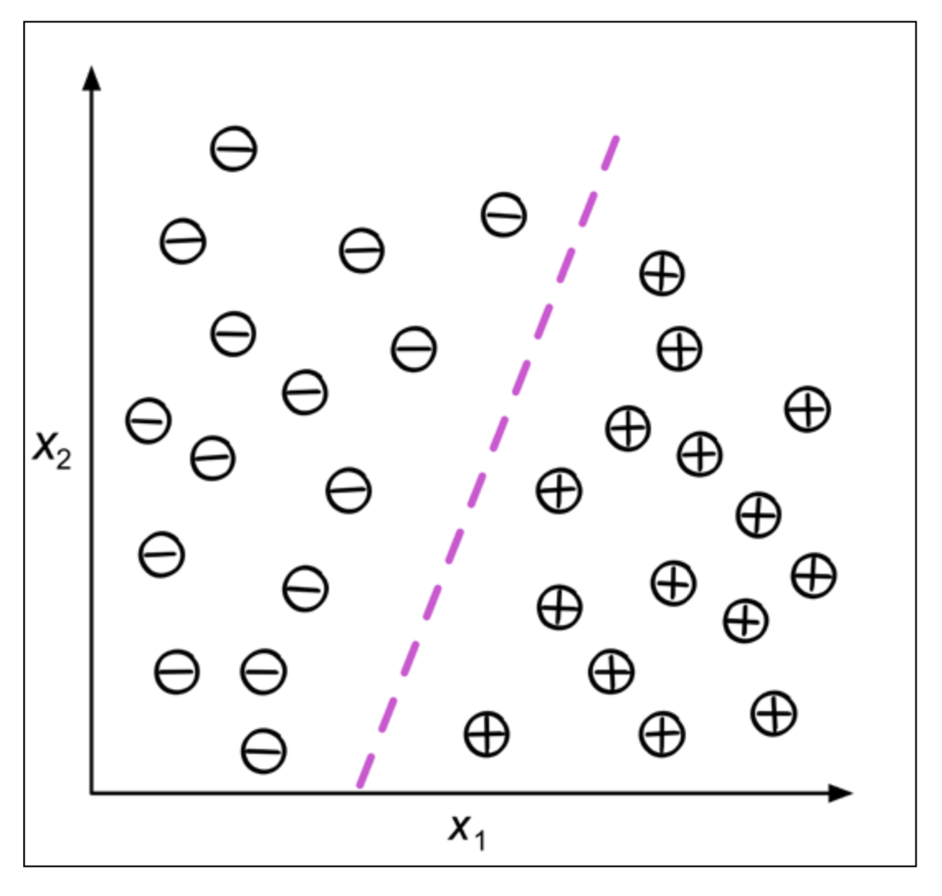

Slide 34
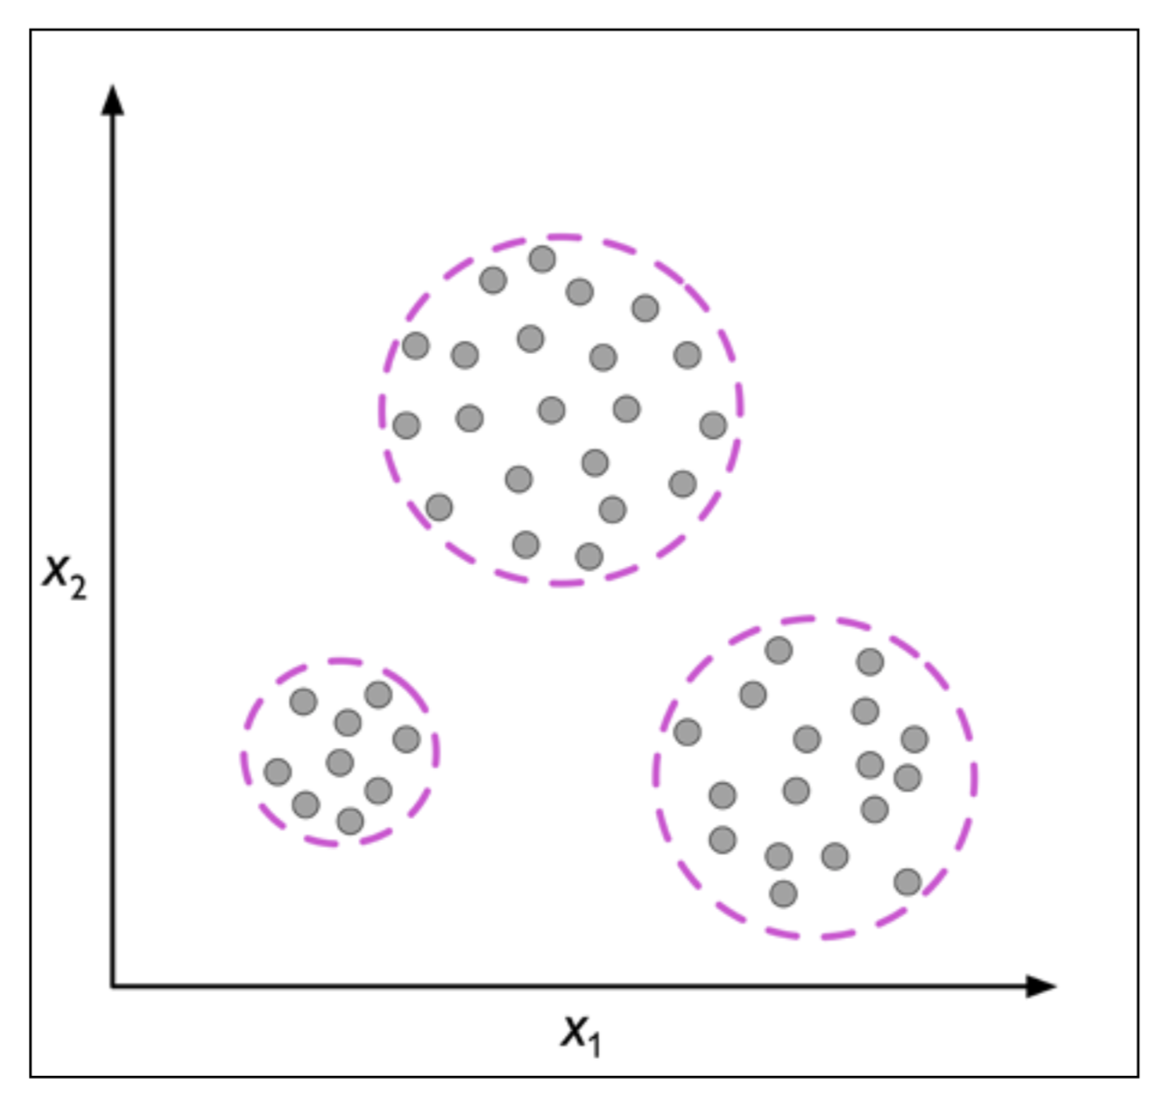
Unsupervised learning 非监督学习

Slide 35
Machine learning Python demo

Slide 36
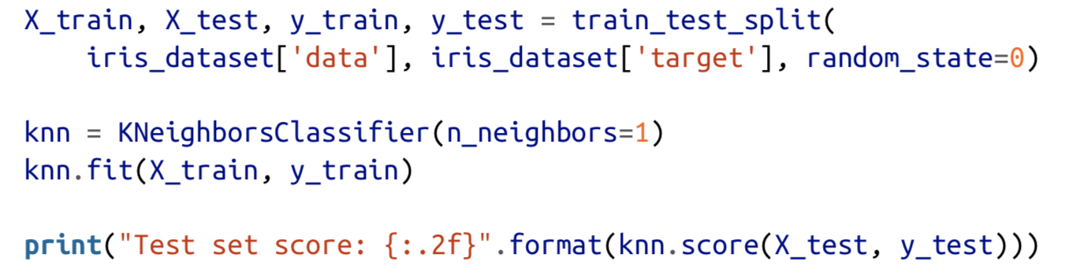

Slide 37
K-NEAREST NEIGHBORS

Slide 38
Naive Bayes 朴素贝叶斯

Slide 39
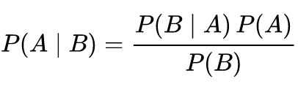
Bayes' theorem

Slide 40
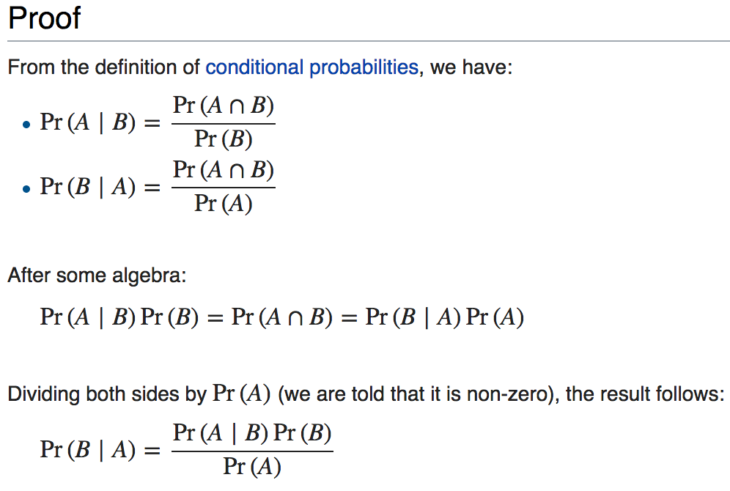

Slide 41
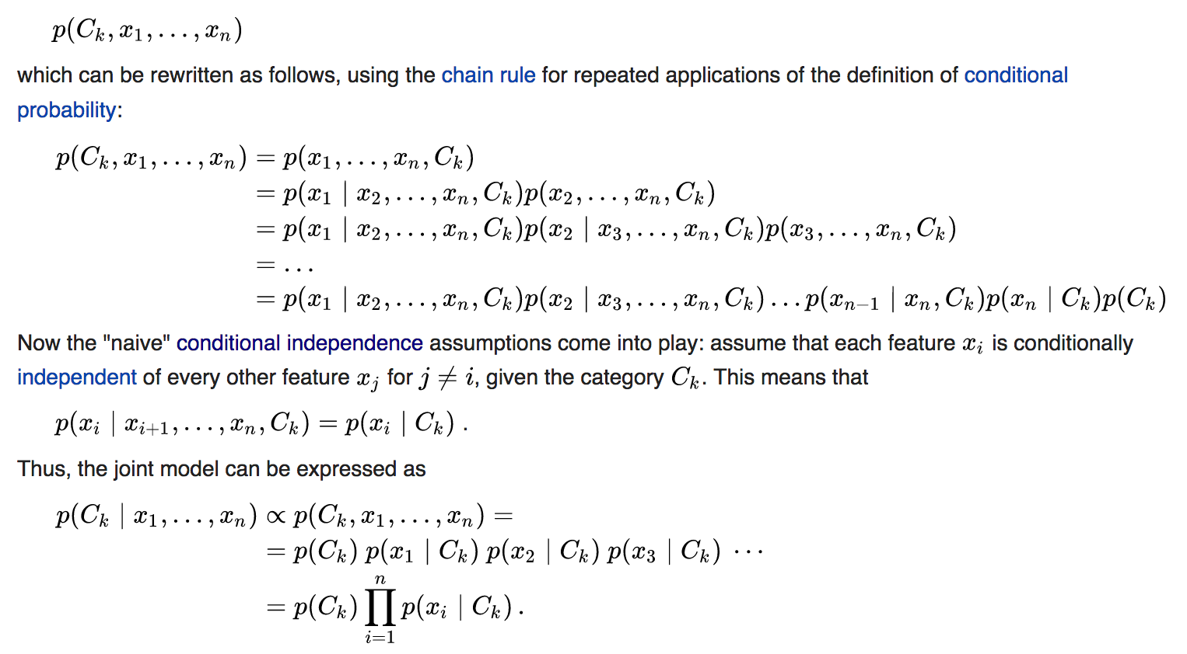

Slide 42
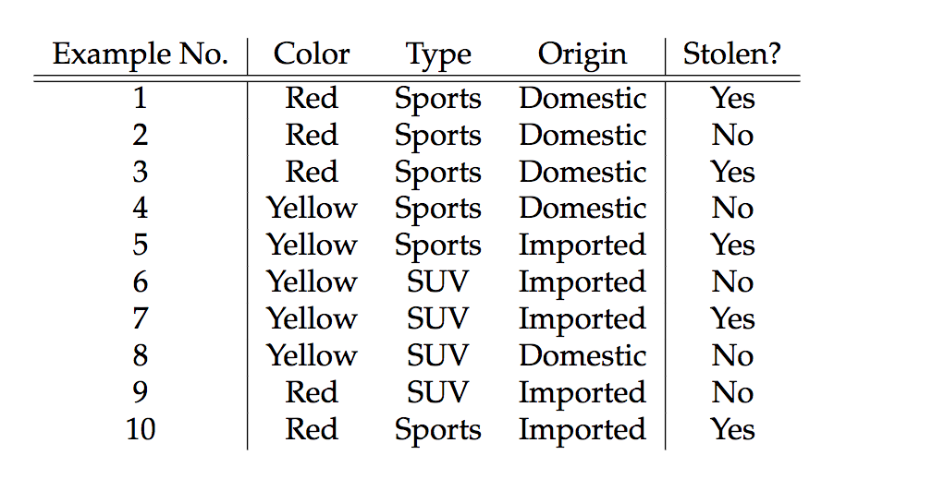

Slide 43
What we want

Slide 44
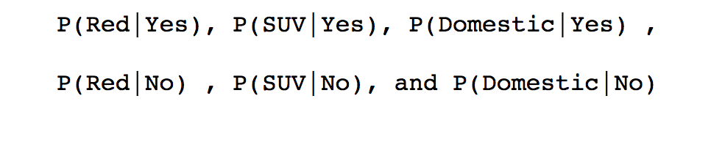
WHAT WE NEED

Slide 45
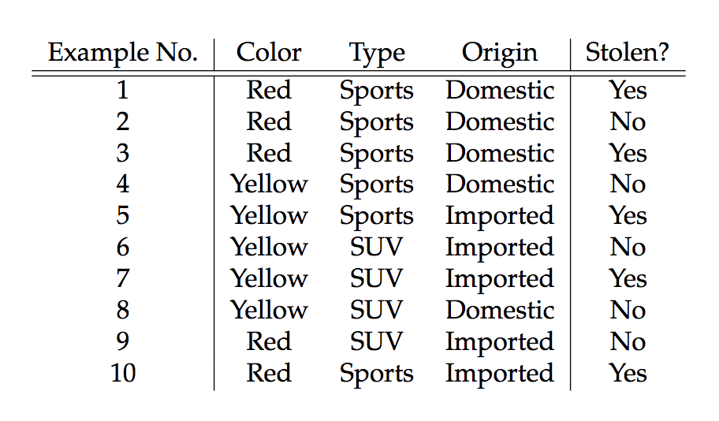
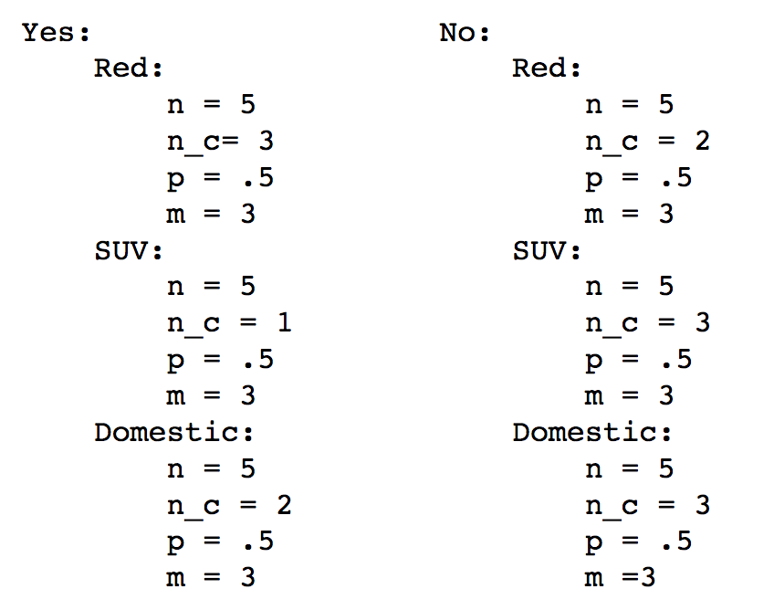

Slide 46
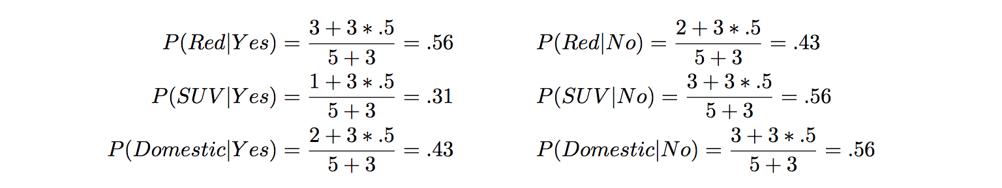

Slide 47
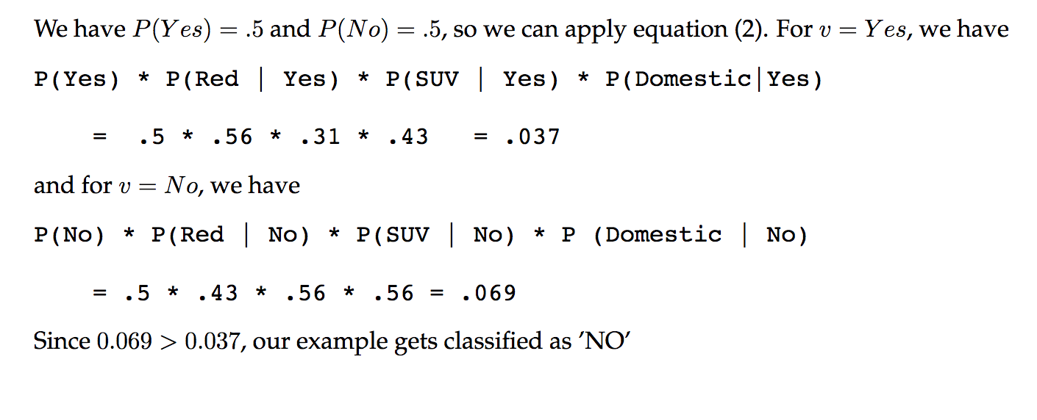

Slide 48
Decision trees 决策树

Slide 49
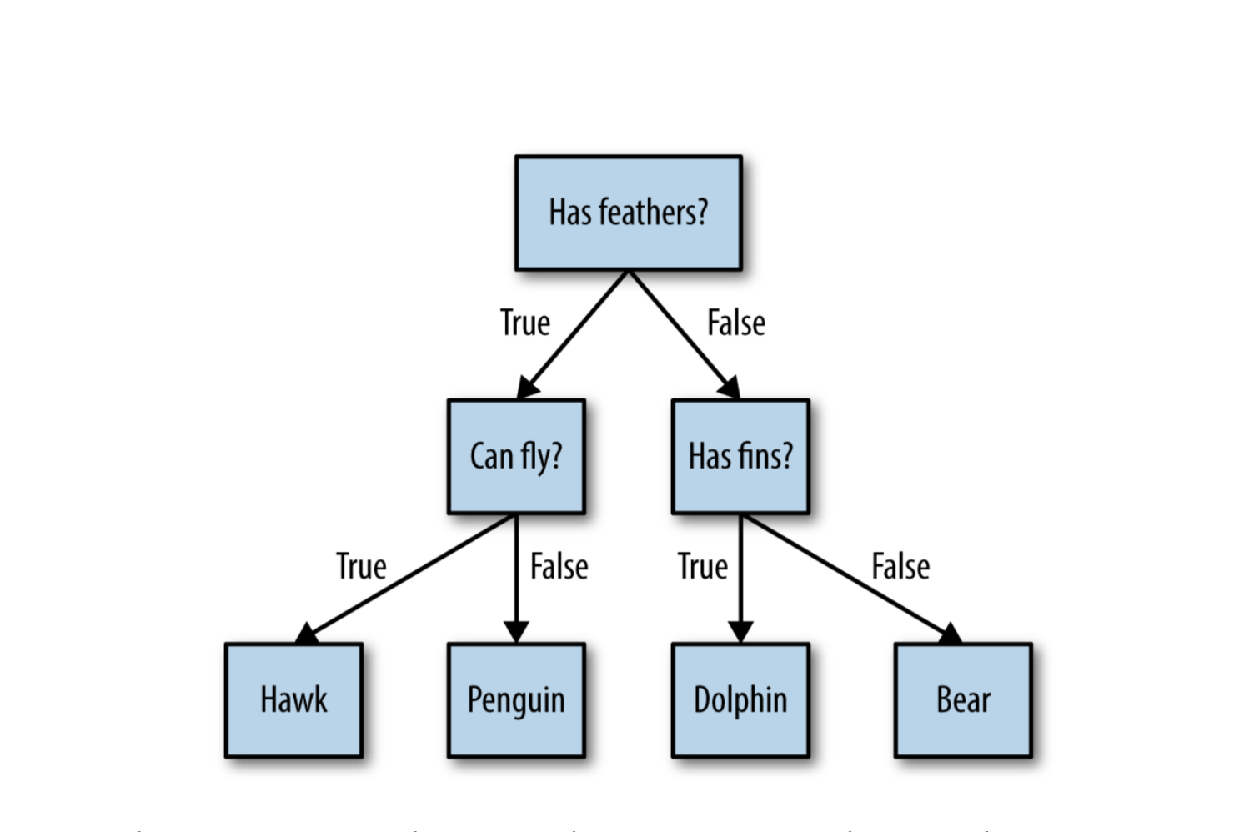

Slide 50
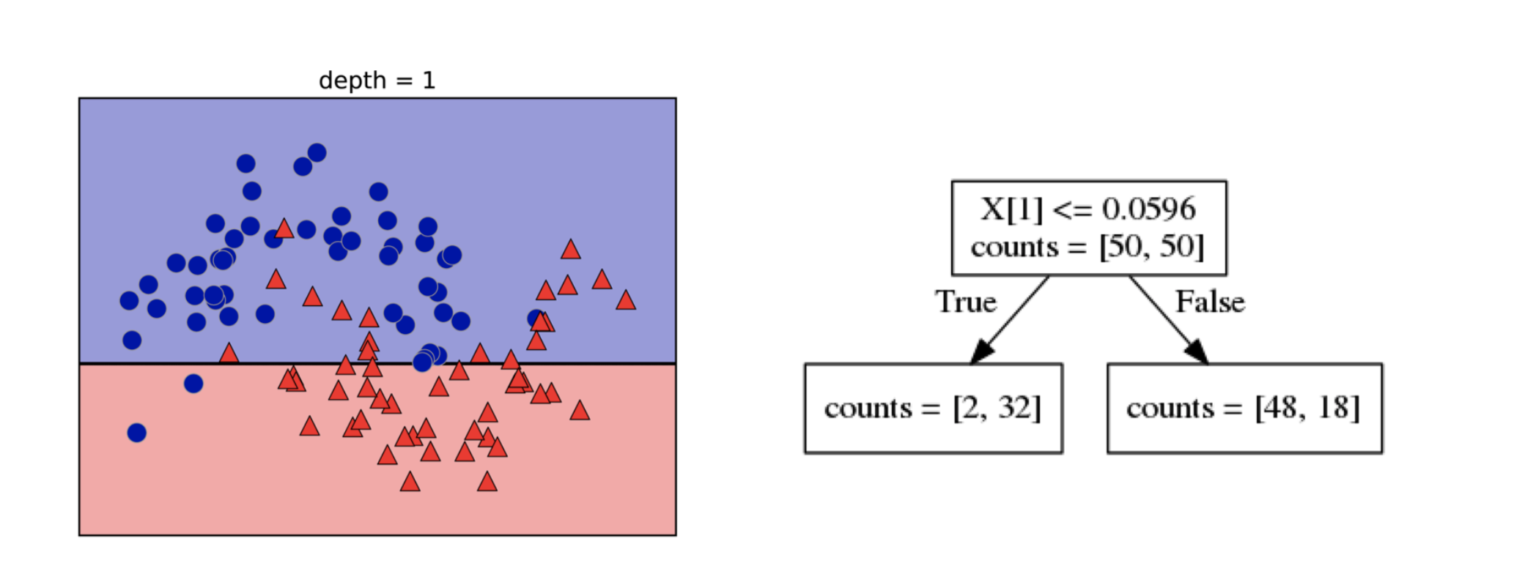

Slide 51
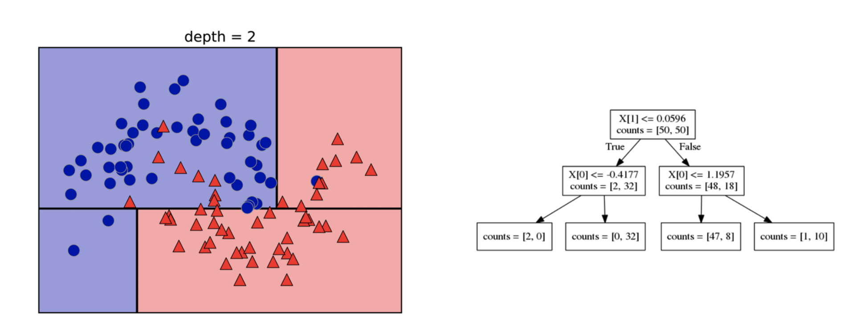

Slide 52
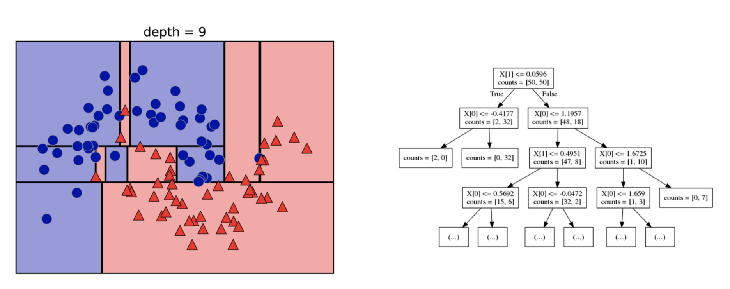

Slide 53
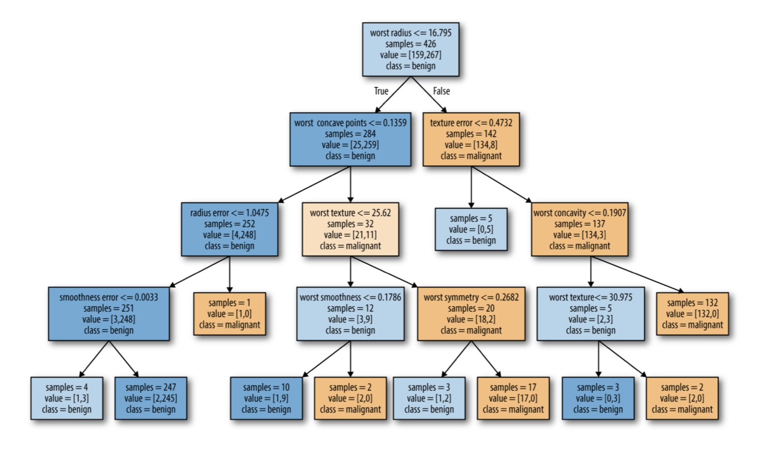

Slide 54
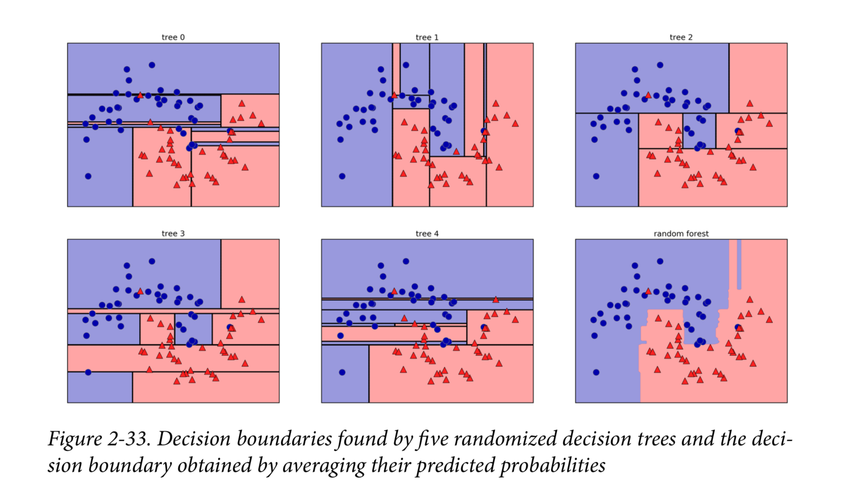
RANDOM FORESTS

Slide 55
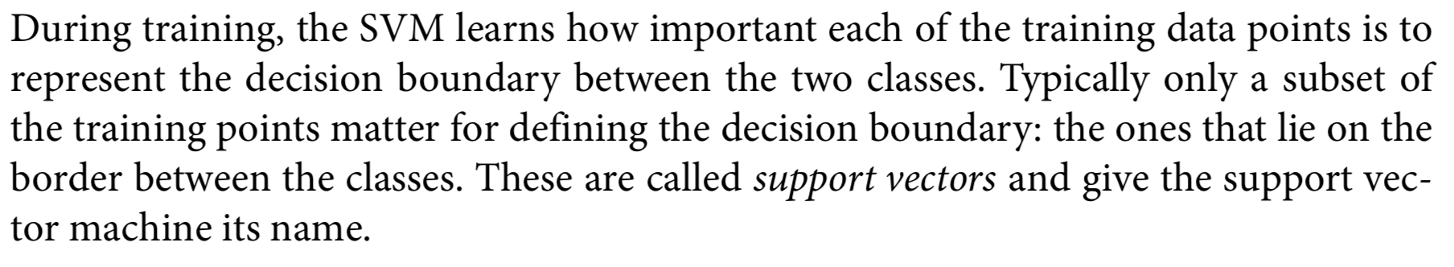
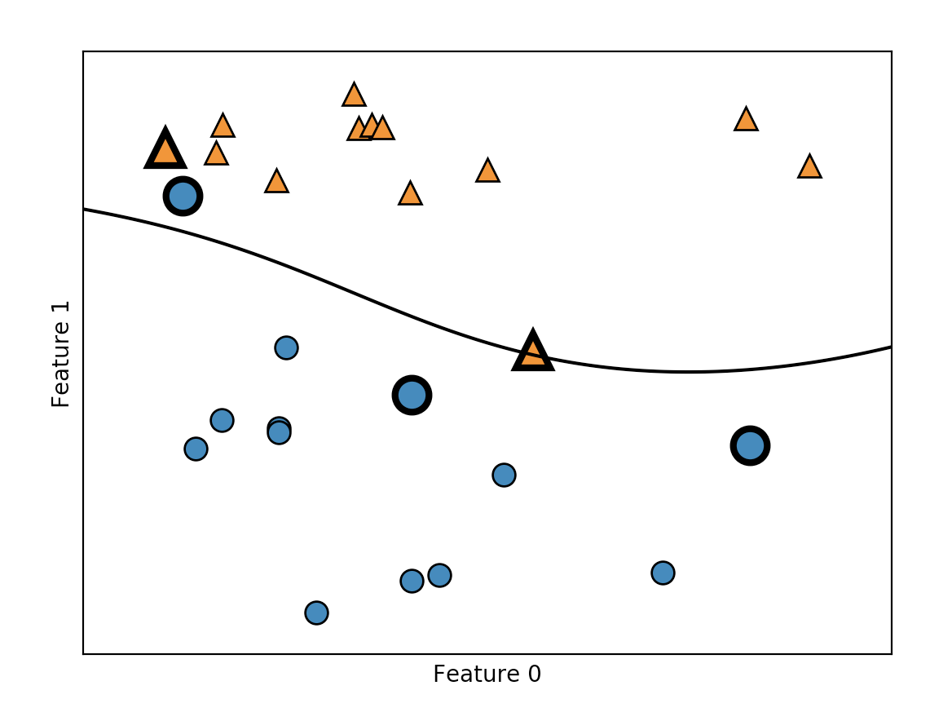
SVM

Slide 56
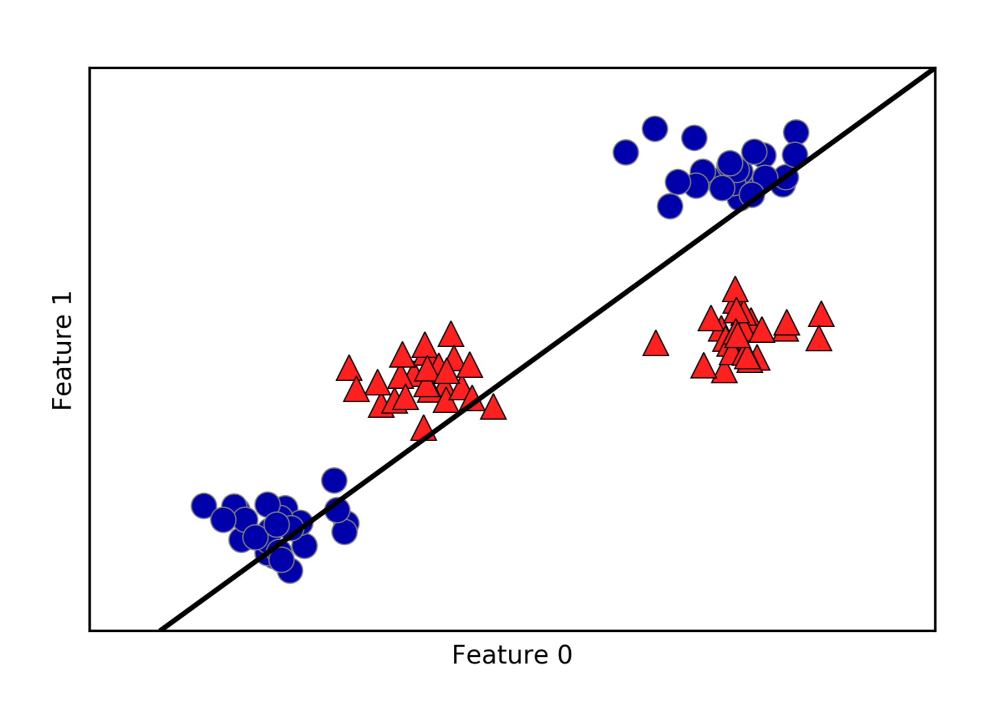
Linear support vector machine

Slide 57
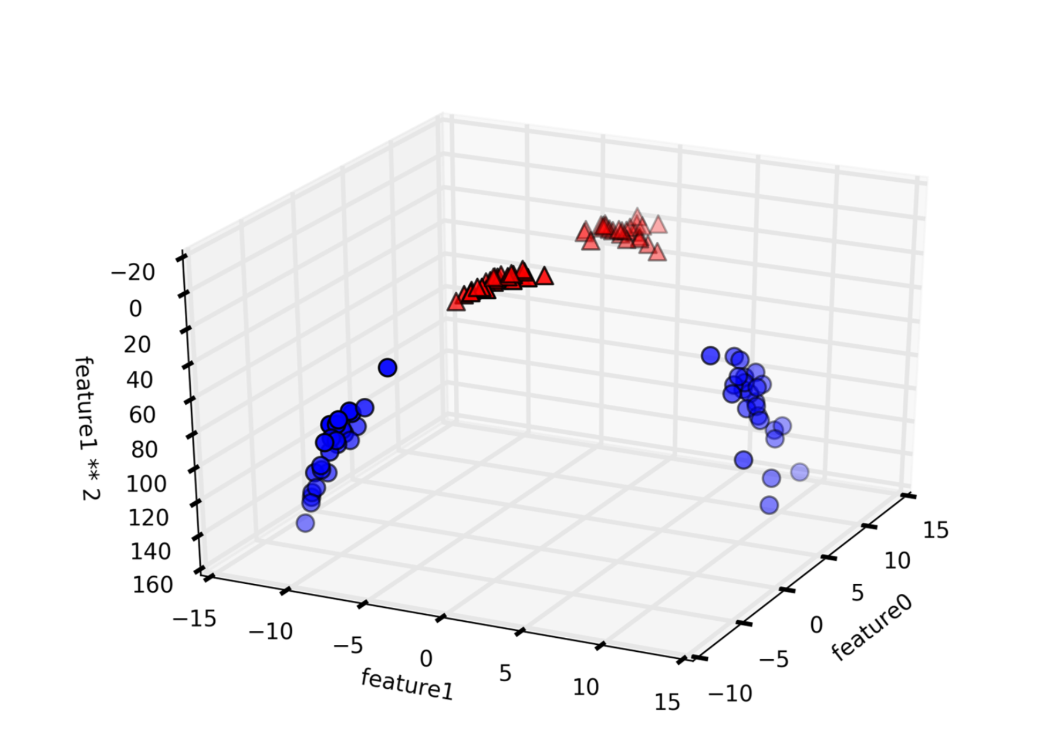

Slide 58
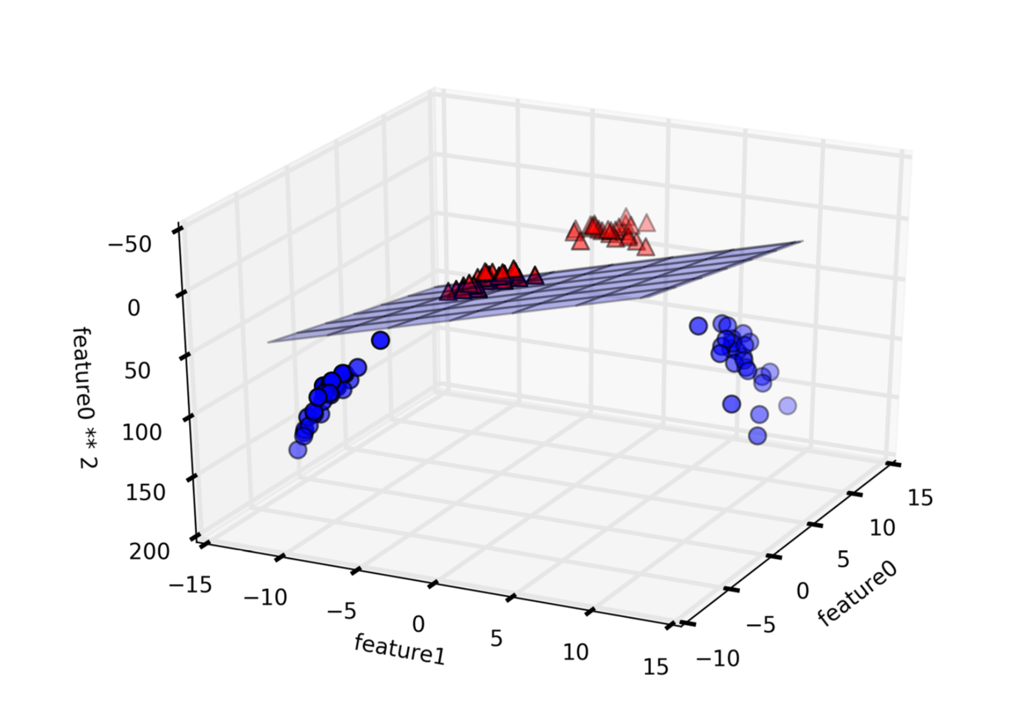

Slide 59
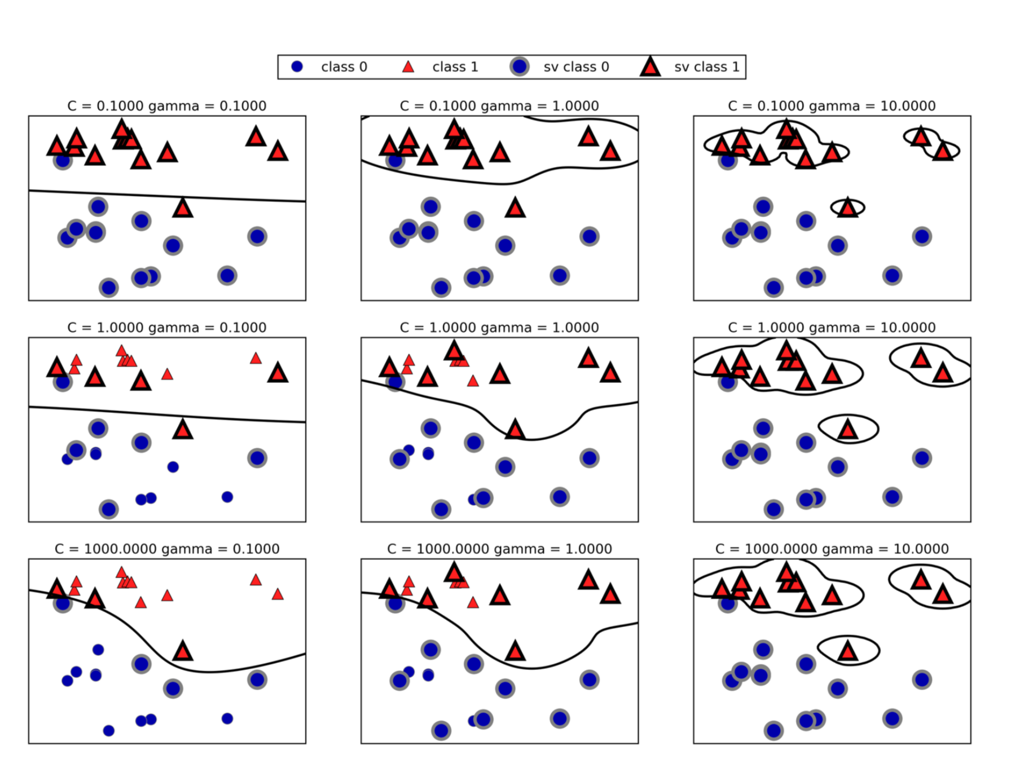

Slide 60
Text retrieval 文本检索

Slide 61
Why
Text (natural language) is the most natural way of encoding human knowledge.
Text is by far the most common type of information encountered by people.
Text is the most expressive form of information

Slide 62
Vector Space Retrieval Model

Slide 63
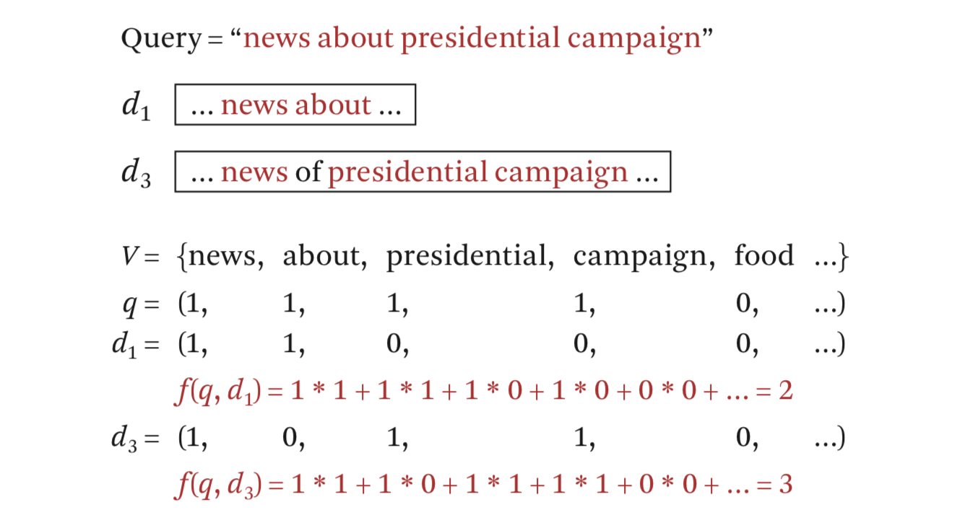
Bit Vector Representation
1: 关键字存在 0: 关键字不存在

Slide 64
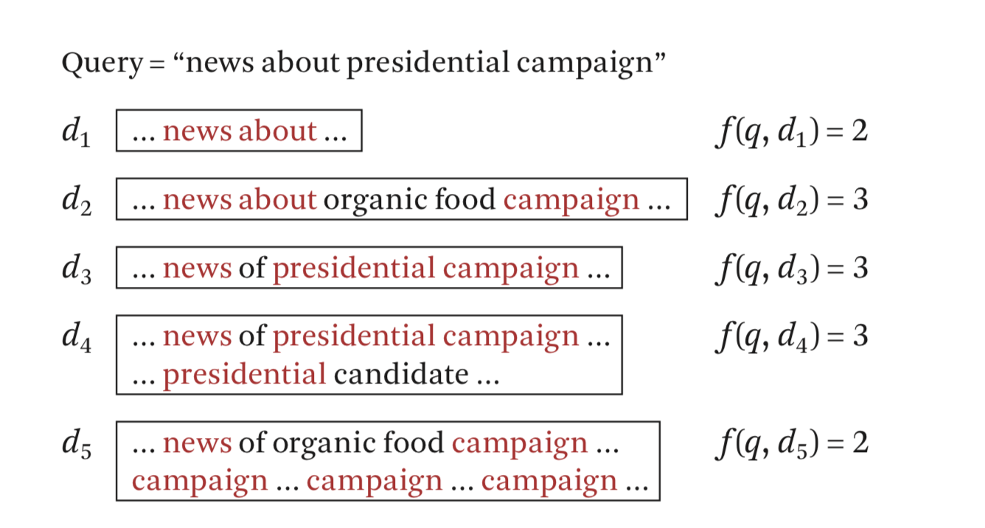
出现的问题：d2==d3==d4

Slide 65
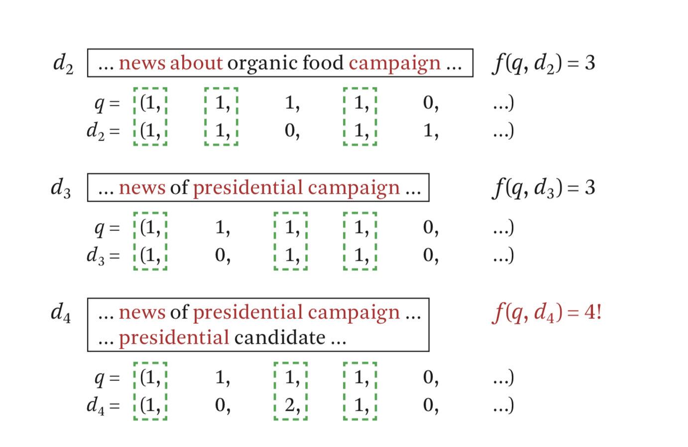
加入关键词出现的频率

Slide 66
出现的问题：d2==d3

Slide 67
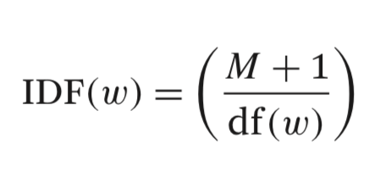
加入idf ：（inverse document frequency ）
M : 所有文件的数量
df(.) : 存在关键字的文档数量

Slide 68
Penalize common words which generally have a low IDF and reward informative words that have a higher IDF
惩罚IDF值低的字，奖励IDF值高的字

Slide 69
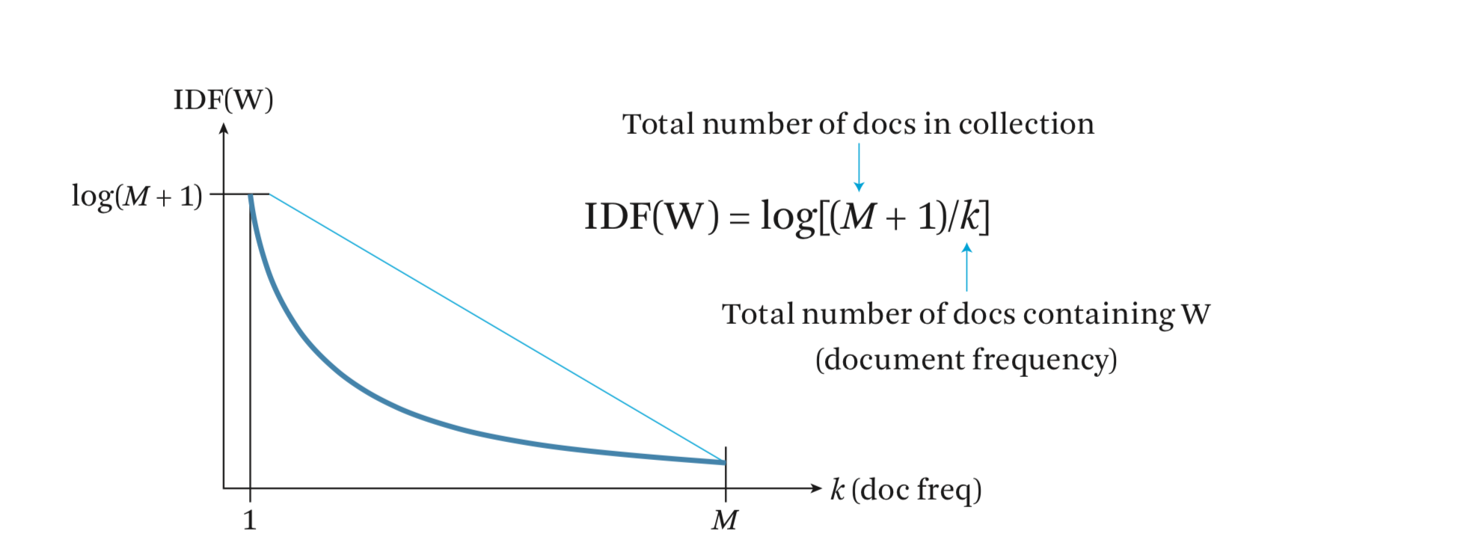

Slide 70
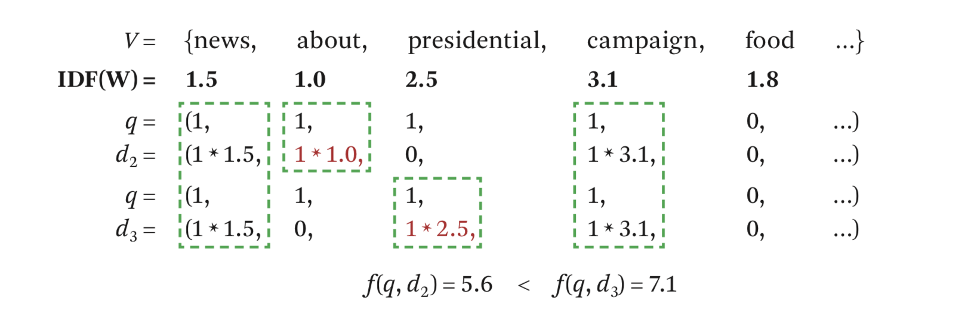

Slide 71
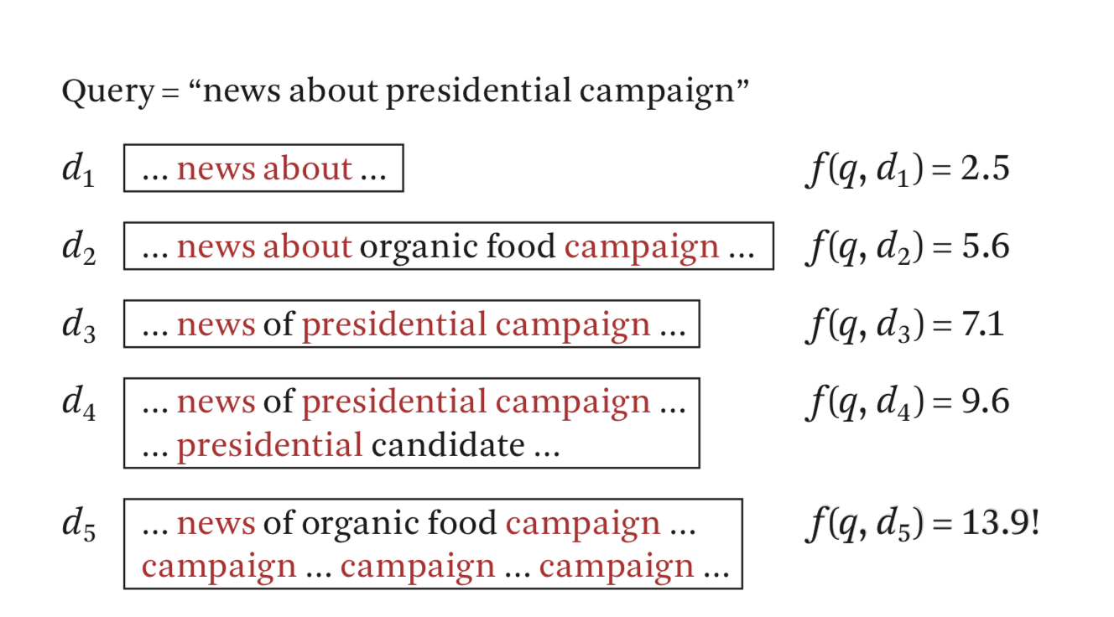
新的问题：d5相关性不大却得到了很高的值

Slide 72

A ranking function
c(w, q) the count of the query term w in the query
c(w, d) the count of w in the document

Slide 73


Slide 74
Probabilistic Retrieval Models

Slide 75


Slide 76


Slide 82
Data mining 数据挖掘

Slide 83
Interdisciplinary subject
Knowledge discovery from data

Slide 84
Difference between data mining and information retrieval

Slide 85
Information retrieval (IR) is the science of searching for documents or information in documents. Documents can be text or multimedia, and may reside on the Web. The differences between traditional information retrieval and database systems are twofold: Information retrieval assumes that (1) the data under search are unstructured; and (2) the queries are formed mainly by keywords, which do not have complex structures (unlike SQL queries in database systems).

Slide 86
1. Data cleaning (to remove noise and inconsistent data)

Slide 87
2. Data integration (where multiple data sources may be combined)

Slide 88
3. Data selection (where data relevant to the analysis task are retrieved from the database)

Slide 89
4.Data transformation (where data are transformed and consolidated into forms appropriate for mining by performing summary or aggregation operations)

Slide 90
5.Data mining (an essential process where intelligent methods are applied to extract data patterns)

Slide 91
6.Pattern evaluation (to identify the truly interesting patterns representing knowledge based on interestingness measures.

Slide 92
7.Knowledge presentation (where visualization and knowledge representation techniques are used to present mined knowledge to users)

Slide 93


Slide 94
STATISTICAL CONCEPTs YOU NEED TO KNOW

Slide 95
Mean

Slide 96
Median

Slide 97
Mode

Slide 98
range

Slide 99

Variance and standard deviation

Slide 100


Slide 101


Slide 102


Slide 103


Slide 104


Slide 105
IGNORE THE TUPLE
This is usually done when the class label is missing (assuming the mining task involves classification). This method is not very effective, unless the tuple contains several attributes with missing values. It is especially poor when the percent- age of missing values per attribute varies considerably. By ignoring the tuple, we do not make use of the remaining attributes’ values in the tuple. Such data could have been useful to the task at hand.

Slide 106
Fill in the missing value manually
In general, this approach is time consuming and may not be feasible given a large data set with many missing values.

Slide 107
Use a global constant to fill in the missing value
Replace all missing attribute values by the same constant such as a label like “Unknown” or −∞. If missing values are replaced by, say, “Unknown,” then the mining program may mistakenly think that they form an interesting concept, since they all have a value in common—that of “Unknown.” Hence, although this method is simple, it is not foolproof

Slide 108
Use a measure of central tendency for the attribute (e.g., the mean or median) to fill in the missing value
For normal (symmetric) data distributions, the mean can be used, while skewed data distribution should employ the median

Slide 109
Use the most probable value to fill in the missing value
This may be determined with regression, inference-based tools using a Bayesian formalism, or decision tree induction.

Slide 110


Slide 111
Binning
Binning methods smooth a sorted data value by consulting its “neighbor- hood,” that is, the values around it

Slide 112


Slide 113
Regression
Data smoothing can also be done by regression, a technique that conforms data values to a function. Linear regression involves finding the “best” line to fit two attributes (or variables) so that one attribute can be used to predict the other. Multiple linear regression is an extension of linear regression

Slide 114
Outlier analysis
Outliers may be detected by clustering, for example, where similar values are organized into groups, or “clusters.” Intuitively, values that fall outside of the set of clusters may be considered outliers (Figure 3.3). Chapter 12 is dedicated to the topic of outlier analysis

Slide 115


Slide 116
Recommender system 推荐系统

Slide 117
内容过滤(content based filtering)
协同过滤(collaborative filtering)

Slide 118
内容过滤：
根据个人喜好进行推荐

Slide 119
协同过滤：
根据其他用户进行推荐
假定条件：
具有相同爱好的用户喜好相近
喜好相近的用户具有相同的兴趣

Slide 120
A -> 1112121111173911
1 -> A
B == A
B -> 2
2 -> A

Slide 121


Slide 122
今日头条推荐算法

Slide 123


Slide 124


Slide 125


Slide 126
Reinforcement learning 强化学习

Slide 127
强化学习是机器学习中的一个领域，强调如何基于环境而行动，以取得最大化的预期利益。
---维基百科

Slide 128


Slide 129
举例：q learning

Slide 130


Slide 131

State and Action

Slide 132
An example from mnemstudio.org

Slide 133

目标 : 5

Slide 134

将到达5的行为奖励100

Slide 135


Slide 136


Create a reward table

Slide 137
-1：不存在
0：无奖励
100： 奖励

Slide 138

Initial state：1
Action : 3 or 5
Random：5

Slide 139



Slide 140




Slide 141
Since 5 is the goal state, this episode is finished.

Slide 142


Slide 143


Slide 144


Slide 145
DEEP LEARNING AND NEURAL NETWORK
深度学习和神经网络

Slide 146

logistic regression

Slide 147


Slide 148


Slide 149


Slide 154
Thanks

